Slide 1
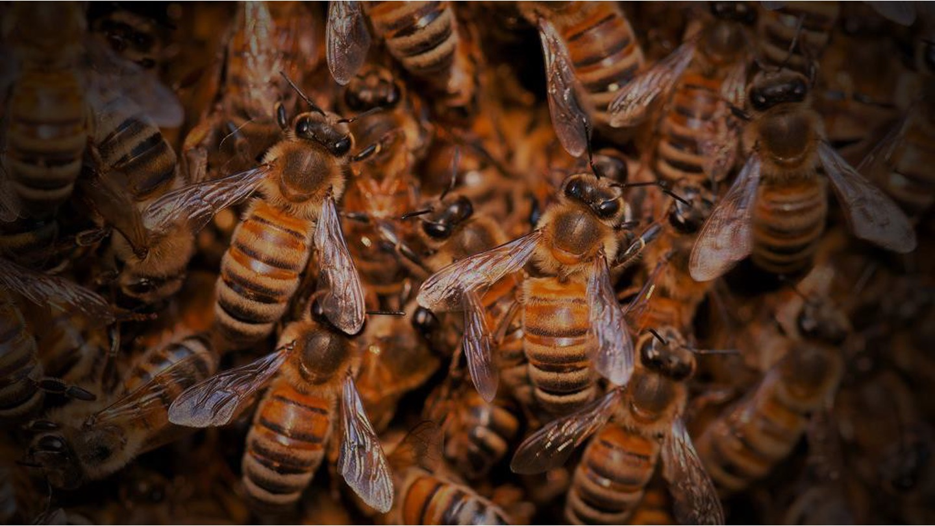
Nonparametric Statistics Project
HONEYBEE HEALTH
Evaluation of risk factors &
strategies to mitigate
colony losses
Marta Cerri (5 CFU)
Luca Mainini (5)
Lupo Marsigli (8)
Eugenio Varetti (8)
Notes:
Good morning to everyone
I'm Luca and today with my collegues Marta, Lupo and Eugenio, we are going to present our project on honeybee health
altro:
Analyses of risk factors, estimation of economic impact and resilience suggestions

Slide 2
Why a project on
bee health ?
Notes:
Bees are one of the most ecologically and commercially important insects in the world and are critical for human survival

Slide 3






Of our global
food supply
is pollinated
by bees
Notes:
pollinating one-third of the food we eat
altro:
Honey bees — wild and domestic — perform about 80 percent of all pollination worldwide. A single bee colony can pollinate 300 million flowers each day.
Grains are primarily pollinated by the wind, but fruits, nuts and vegetables are pollinated by bees. Seventy out of the top 100 human food crops — which supply about 90 percent of the world’s nutrition — are pollinated by bees.

Slide 4





















HONEYBEES
are responsible for
$170 billion*
a year in crops
* $20 Bln only in US (2019, Scott McArt)
Notes:
for an estimated economic global impact on agricultural yields of 170 Bln dollars
altro:
It is indeed estimated that the production of some seed and nut crops would decrease by up to 90\% without these pollinators.
This fact is extremely important considering that human population is still increasing and may generate sustainability problems

Slide 5
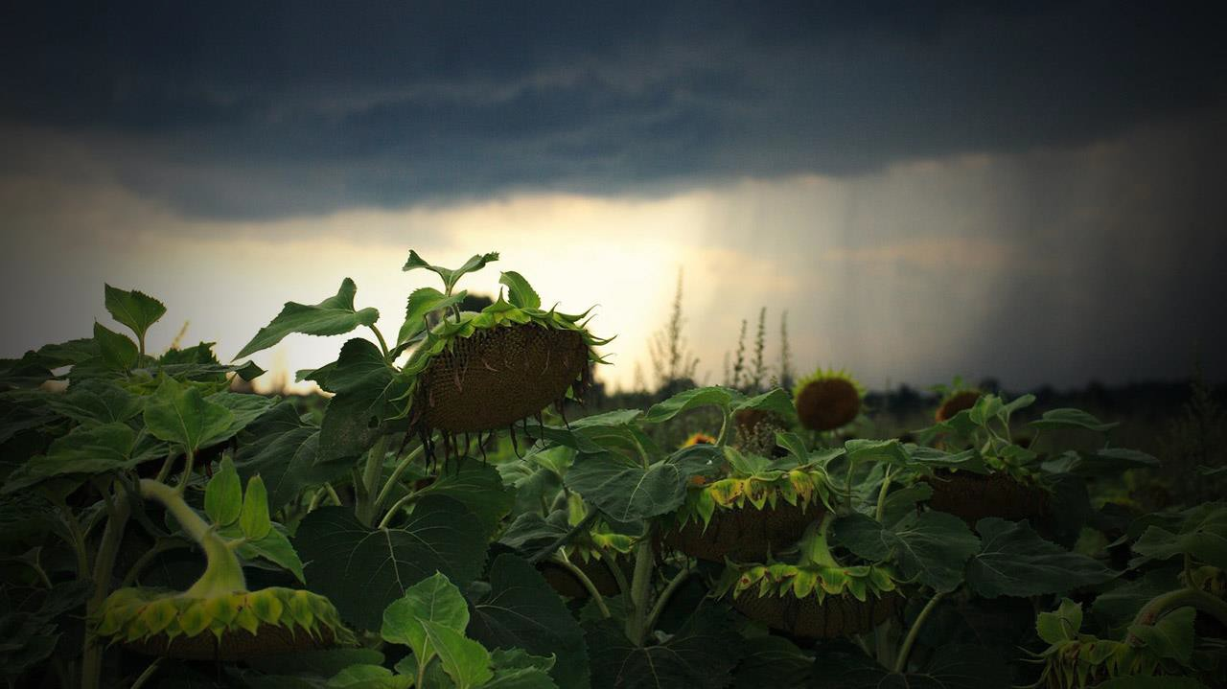






Notes:
because pollination aids in tree regeneration, bees also help to maintain native ecosystems and are important in preserving biodiversity

Slide 6
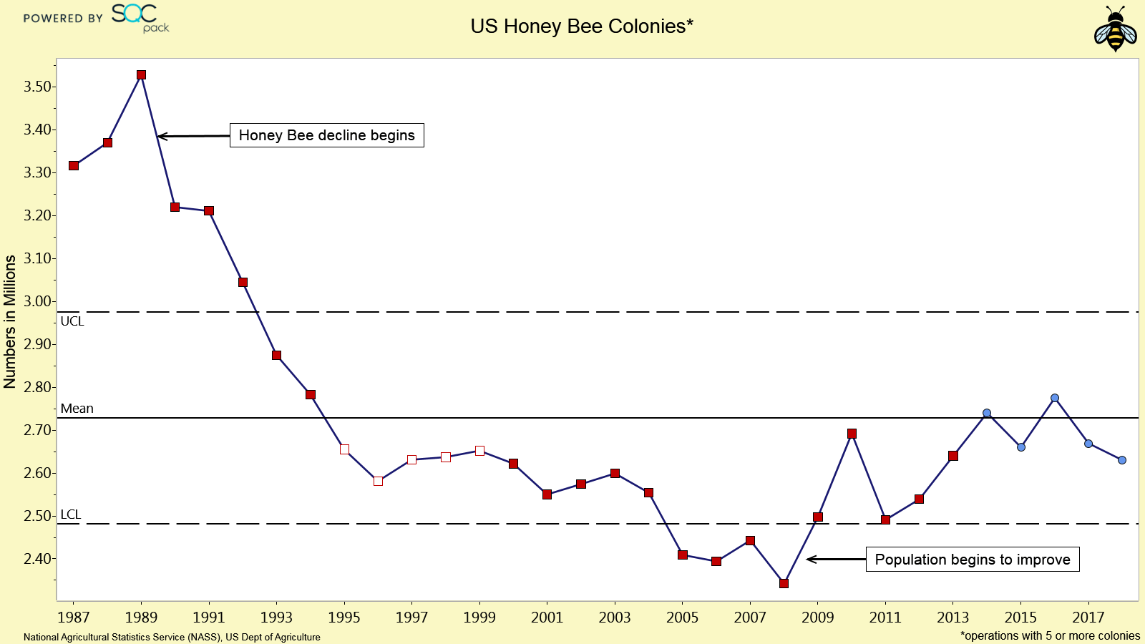
There are significant gaps in our understanding of honey bee behaviour
CCD
Notes:
Despite their importance, an urgent worry has been raised in the last 20 years due to the global decline in honey bee numbers

Slide 7
Our project addresses
PUBLIC OPINION
and
GOVERNMENT AUTHORITIES
Notes:
the problem is still largely ignored despite the scale of the phenomenon.
Our project addresses public opinion and government authorities with the aim of raising awareness of the issue

Slide 8
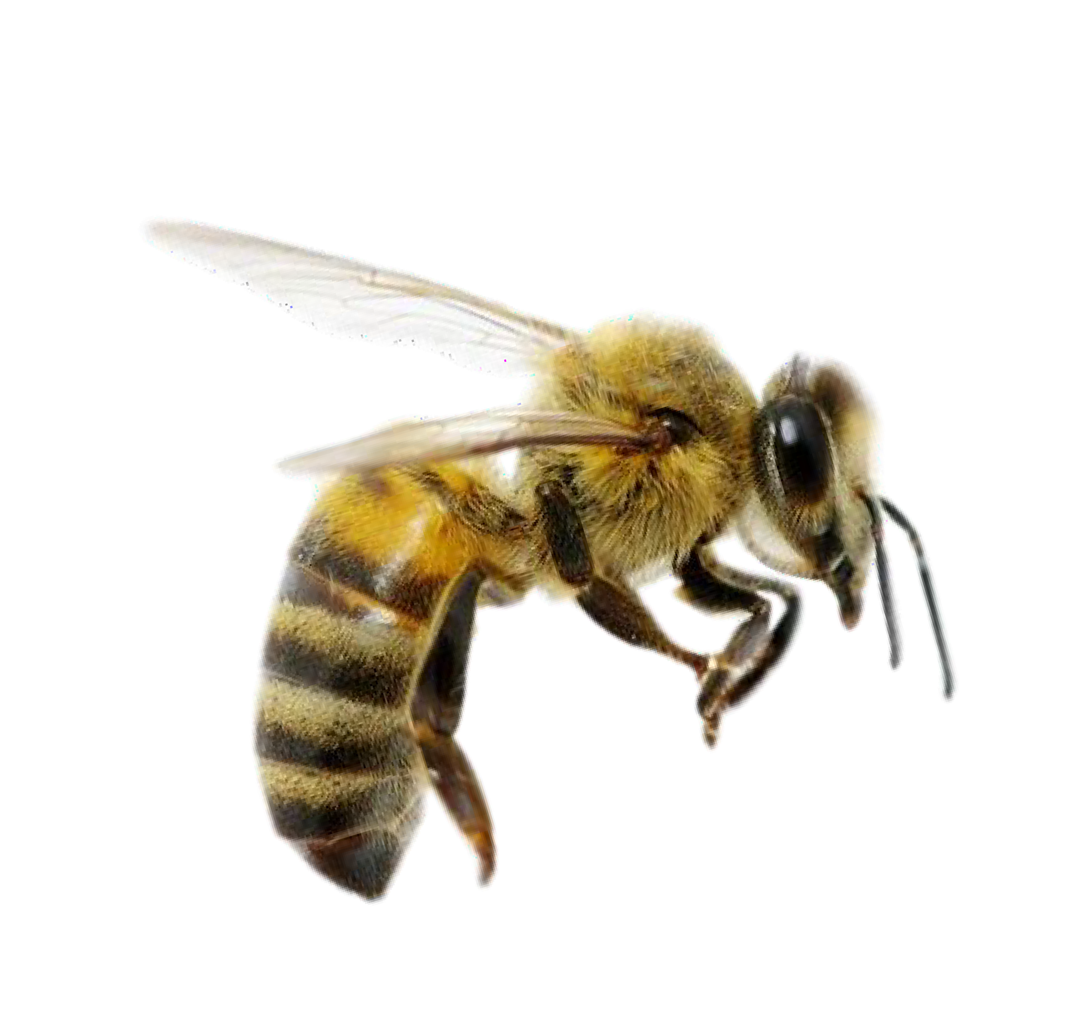
RESEARCH QUESTIONS
REASONS
IMPACT
RESILIENCE
Is there a relation a between stressors and colony losses?
Which is the economic impact of the colony losses?
Which are the most favorable environments?
Notes:
In particular our research is aimed at ...

Slide 9
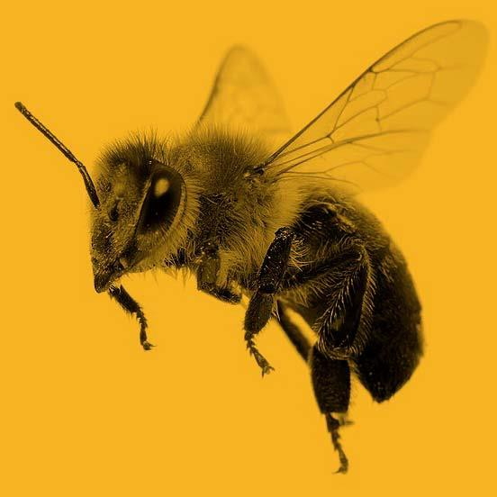
DATA
IMPORT & CLEANING
Notes:
For our analysis, we used different types of data taken from different public dataset

Slide 10

Data
Number of colonies
Number of colonies at the beginning of the quarter
Q1: January - March
Max number of colonies
Colonies plus all colonies moved into that state during the quarter
For each state in US:
Colony lost
Percentage and absolute values of colony lost
Q2: April - June
YEAR
from 2015 to 2022
Colony added
Colony that was either created or purchased
Q3: July - September
Colony renovated
Number of surviving colonies that were renewed
Stressors
Percentage of colonies affected by different types of stressors (1 feature each)
Q4: October - December
Diseases
Pesticides
Other
Varroa mites
Honey Production
Annual yields per state
Honey Price
Average annual honey price per state
Notes:
From the website of the US Department of Agriculture, we imported 3 dataset:
one on the number of lost, renovated and added colonies per semester in the years from 2015 and 2022
one on the factors that stress these colonies as pesticides, diseases and mites
one on the annual honey production and average price

Slide 11


Data
Average
Maximum
Temperature
For each state in US:
Minimum
Drought
PDSI
Possible explanatory factors
Precipitation
Notes:
we also obtained data on temperature, drought and precipitation from the national centers for Environmental Information

Slide 12
GENERAL TRENDS IN DATA

Slide 13
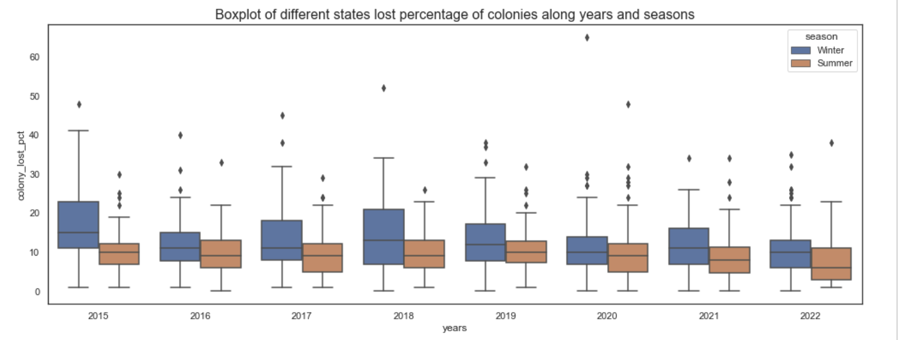
Losses are higher in winter
Global Permutational test for functional data: there is statistical evidence of difference in distribution between summer and winter.
Notes:
in particular, we performed a LOCAL PERMUTATIONAL TEST FOR DIFFERENCE IN COLONY LOST PCT POPULATION BETWEEN SUMMER AND WINTER

Slide 14
INFLUENCE
OF THE
WEATHER

Slide 15
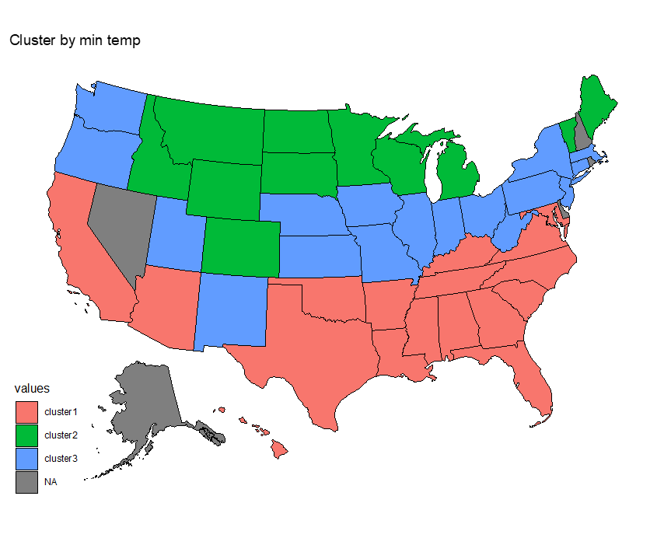
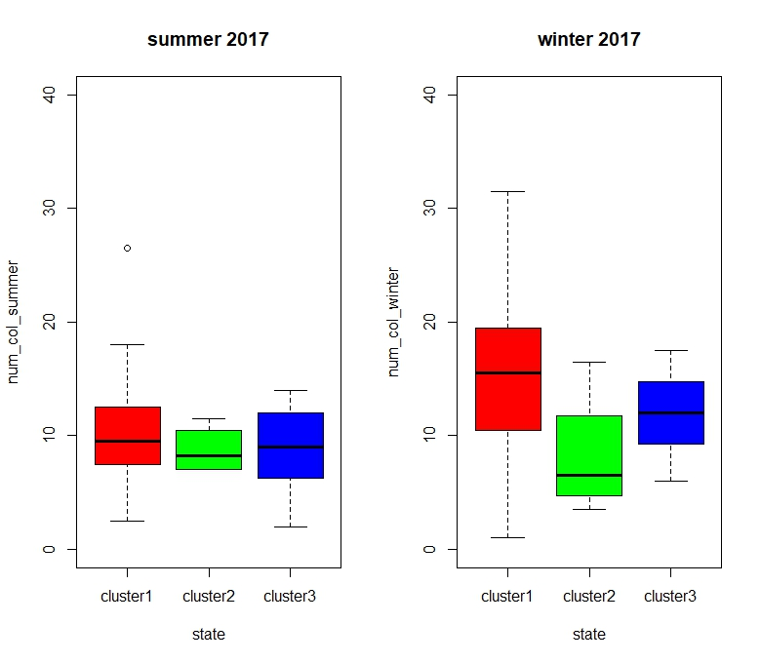
An apparent paradox: increased colony mortality in warmer states
Cluster by minimum temperature
Cluster 1:Subtropical/ Mediterranean
Cluster 2: Alpine
Cluster 3: Continental

Slide 16
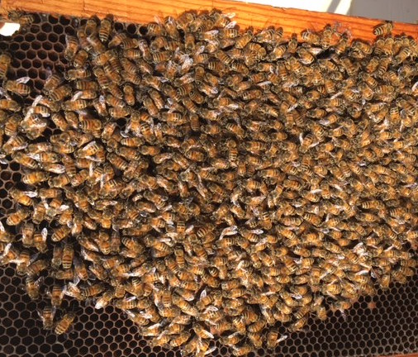
Cold winters do not kill a healthy colony
As temperature drops below 10°C, bees come together to form a “winter cluster” (they can stay at 25-30°C).
During late autumn, cold spells with adequate duration and intensity trigger colony wintering at the right time
Notes:
According to our first analysis, winter is the season where bees are most at risk, but not only for the cold.
Colonies are lost during the winter due to viruses, parasites (as Nosema Apis) and diseases. Some of these virus are related to Varroosis. If the infestation by Varroa Mites is high at the beginning of winter and nothing is done to decrease it, their chances of survival can dramatically drop.
Other winter problems can be pesticide build up in stored pollen, starvation or a failed queen.

Slide 17
IMPACT ON BEEKEEPERS

Slide 18
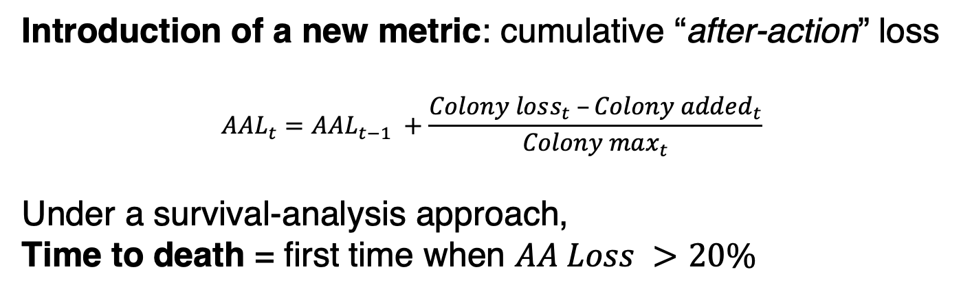
Should government be worried about beekeepers not able to cope with colony losses?
Introduction of a new metric: cumulative “after-action” loss
$$AAL_{t}=AAL_{t−1} +\frac{Colony loss_{t} –Colony added_{t}}{Colony max_{t}}$$
Under a survival-analysis approach,
Time to death = first time when $AA Loss >20\%$
Notes:
To better understand if a governmental action is needed, we would like to understand if beekeepers able to cope with these losses?
AA LOSS = relative loss that takes into consideration the colony added by beekeepers to cope with colony losses
first quarter in which the cumulative “after-action” losses % exceed 20%

Slide 19
In many states,
beekeepers
do not cope
with first
year losses
1st year
Notes:
Survival Analysis:

Slide 20
Dry conditions and fall heatwaves are linked
with increased colony mortality
$$h_{i}\left(t | X_{i}\right)=h_{0}\left(t\right)exp{(β_{1}AverageTemp_{i}+β_{2}Precipitation_{i}+β_{3}PDSI_{i}+β_{4}cluster2_{i}+β_{5}cluster3_{i})}$$
Average Temperature
Precipitation
Palmer Drough Index
Group 1 (min_temp)

Slide 21
BIO-CHEMICAL STRESSING FACTORS
Notes:
Bee’s colonies are stressed by multiple different factors

Slide 22
Pesticides seem the main causes
of summer losses
0.66 Spearman correlation (Pesticides, Loss %)
0.54 Spearman correlation (Diseases, Loss %)
0.41 Spearman correlation (Varroa Mite, Loss %)
Notes:
Pesticides seem the main causes of summer losses according to Spearman rank correlation coefficients
Other important factors are Diseases and Varroa Mite
There is no unique stressor able to explain winter loss

Slide 23
Varroa destructor: the most devastating honey bee pest
Notes:
The Varroa mite is the factor that stress the highest number of colonies.
Varroa is a highly efficient vector of honey bee viruses.
Altro:
Colonies with low infestation generally show very few symptoms, however as the mite population increases symptoms become more apparent. Heavy Varroa mite infestations can build up in 3–4 years and cause scattered brood, crippled and crawling honey bees, impaired flight performance, a lower rate of return to the colony after foraging, a reduced lifespan and a significantly reduced weight of worker bees. Colony symptoms, commonly called parasitic mite syndrome, include an abnormal brood pattern, sunken and chewed cappings and larvae slumped in the bottom or side of the cell. This ultimately causes a reduction in the honey bee population, supersedure of queen bees and eventual colony breakdown and death.

Slide 24
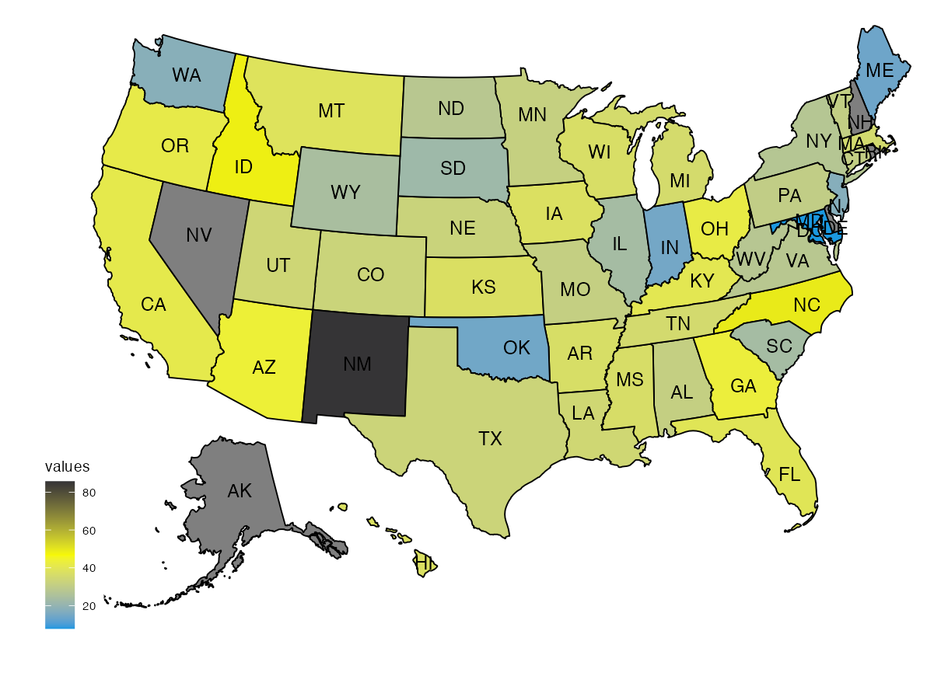
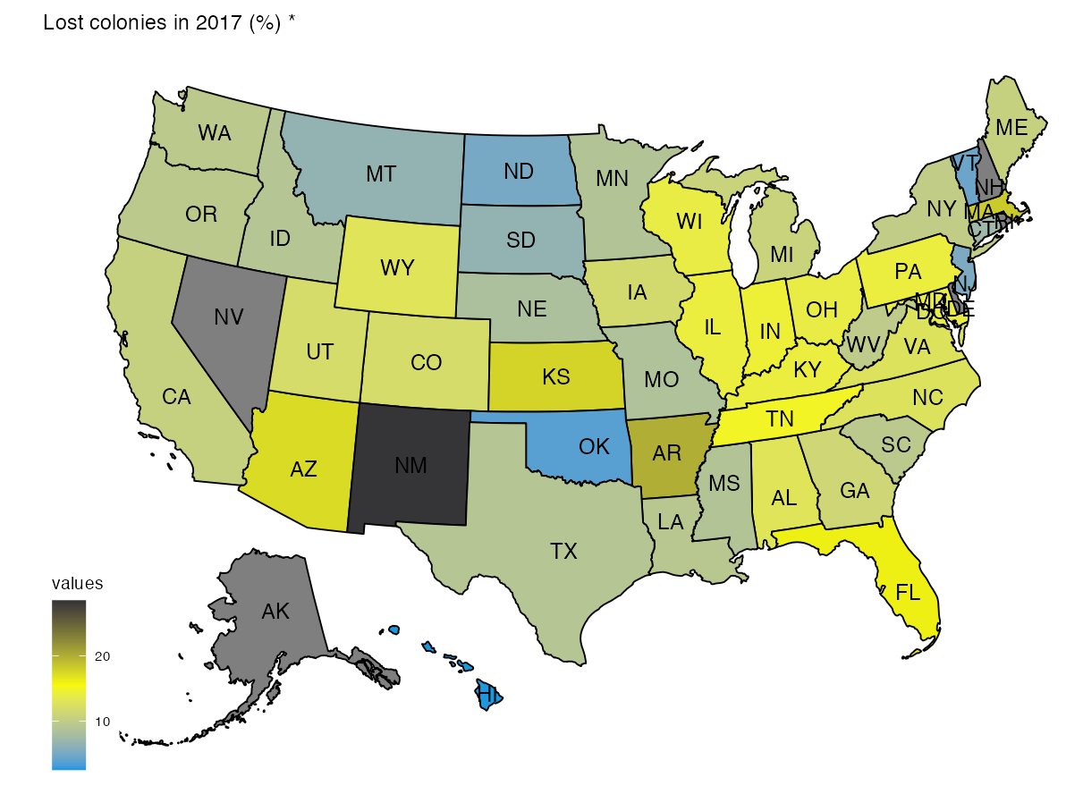
In some years, number of losses and Varroa show the same pattern
Lost colonies (%)
Stressed colonies by Varroa mites (%)

Slide 25
MODELLING OF LOSS -STRESSORS RELATION

Slide 26
Generalized Additive Models
$$n_{i}∼Bin\left(Max n_{i},π_{i}\right)$$
$$logit\left(π_{i}\right)=f\left(Stressors_{i}\right)+f\left(MinTemp_{i}\right)+f\left(space,time\right)+ϵ_{i}$$

Slide 27
ECONOMIC
IMPACT
Notes:
Moving away from interpreting the effect of ecological factors on colony losses, the final result we want to provide to our stakeholder, the government, is a visualization and quantification of the impact that colony losses can have on US economy.

Slide 28
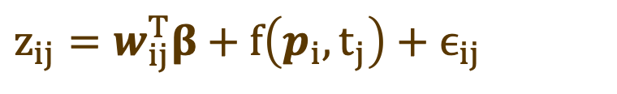
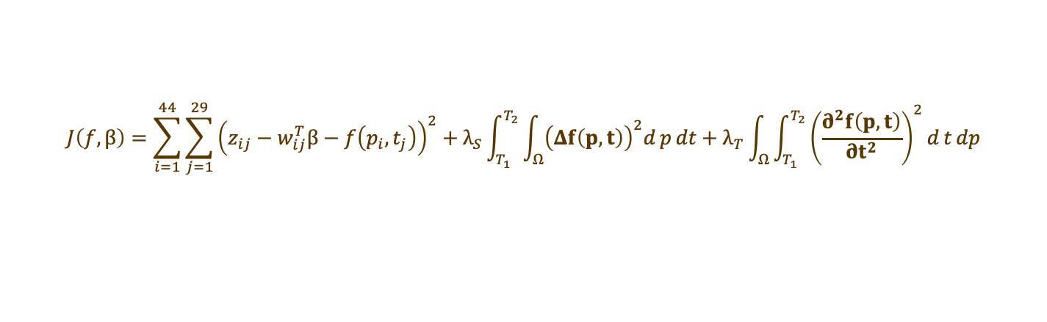
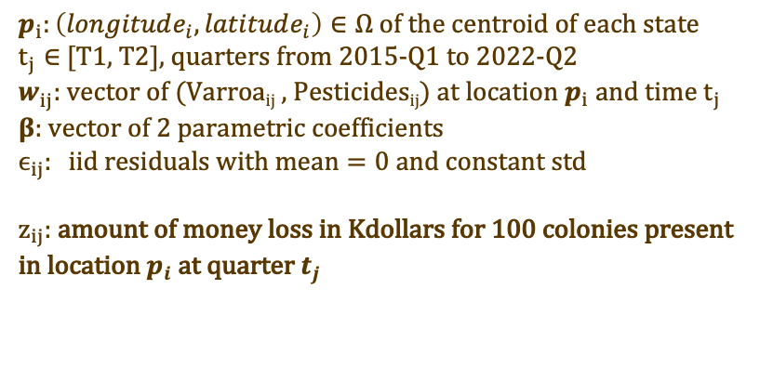
Penalized Semiparametric Regression Model for Spatial Functional Data
$$z_{ij}=w_{ij}^{T}β+f\left(p_{i},t_{j}\right)+ϵ_{ij}$$
state i=1,…,44, time j=1,…,29
$p_{i}:\left(longitude_{i}, latitude_{i}\right)∈Ω of the centroid of each state$
$t_{j}∈$ [T1, T2], quarters from 2015-Q1 to 2022-Q2
$w_{ij}^{ }:$vector of (Varroa_{ij} , Pesticides_{ij}) at location $p_{i}$ and time $t_{j}$
$β$: vector of 2 parametric coefficients
$$ϵ_{ij}: iid residuals with mean=0 and constant std$$
$z_{ij}$: amount of money loss in Kdollars for 100 colonies present in location $p_{i}$ at quarter $t_{j}$
Minimize the following penalized sum of squares criterion:
$$J\left(f,β\right)=\sum_{i=1}^{44}{\sum_{j=1}^{29}{{\left(z_{ij}−w_{ij}^{T}β−f\left(p_{i},t_{j}\right)\right)}^{2}}}+λ_{S}\int_{T_{1}}^{T_{2}}{\int_{Ω}{{\left(Δf\left(p,t\right)\right)}^{2}d}p}dt+λ_{T}\int_{Ω}{\int_{T_{1}}^{T_{2}}{{\left(\frac{∂^{2}f\left(p,t\right)}{∂t^{2}}\right)}^{2}d}t}dp$$
Notes:
For this task, we implemented a penalized semiparametric regression model for spatial functional data.
as target variable, we consider the overall amount of money lost in Kilo dollars for 100 colonies present at a given location and time.
we want to regress it over a nonparametric spatio-temporal field and a parametric term with the two main stressors, Varroa and Pesticides;
This model is based on the idea of regression with partial differential regularizations: we consider here two roughness penalties that account separately for the regularity of the field in space and in time
(((( f and beta are obtained solving a minimization task where roughness penalties are the integrals over laplacian of f and second derivative of t))))

Slide 29
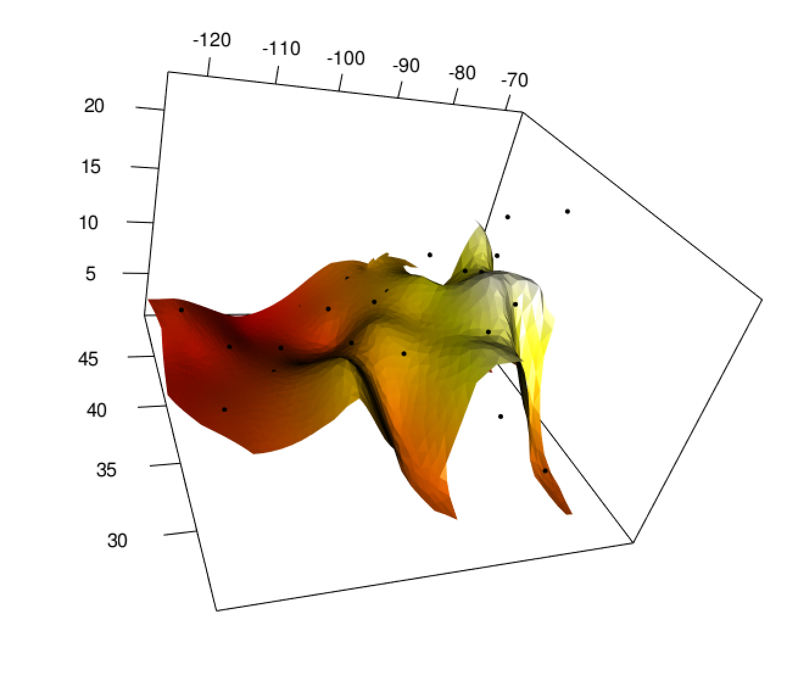
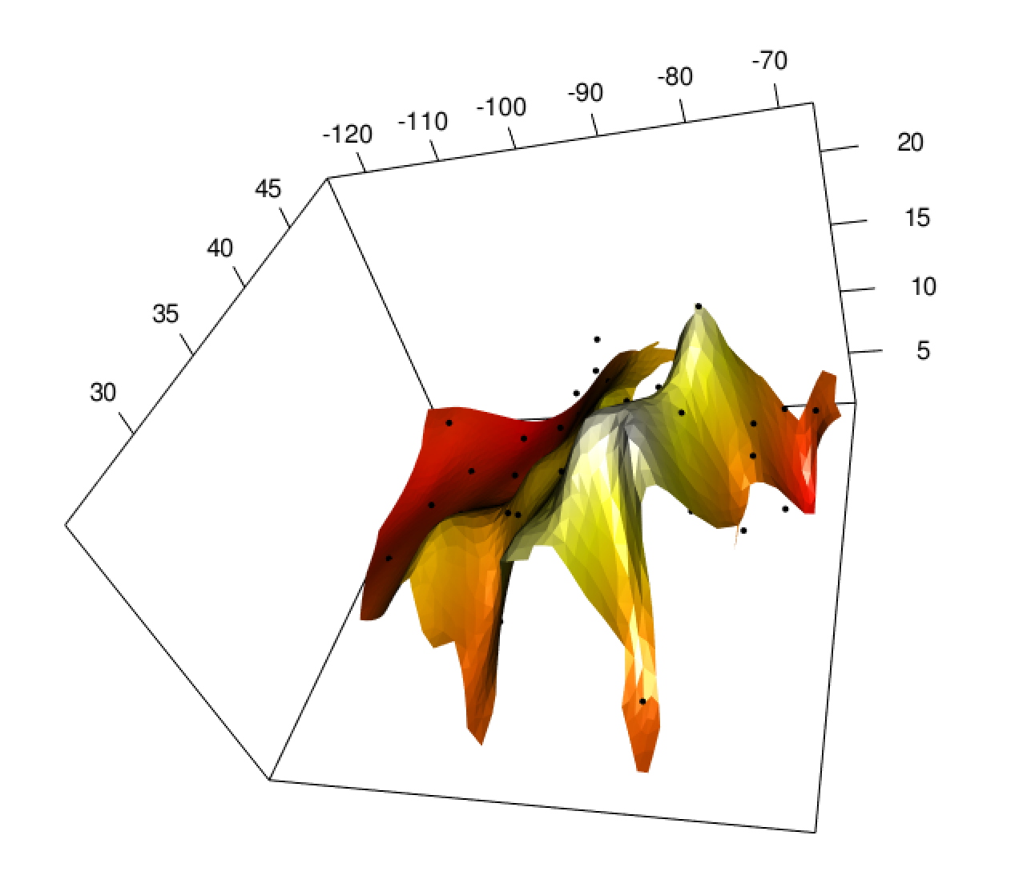
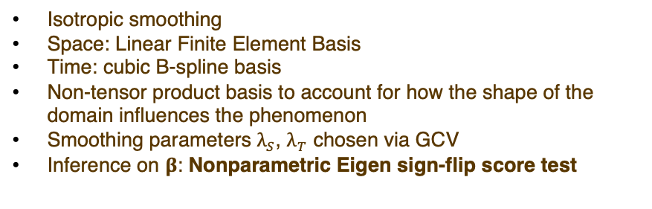
Penalized Semiparametric Regression Model for Spatial Functional Data
Isotropic smoothing
Space: Linear Finite Element Basis
Time: cubic B-spline basis
Non-tensor product basis to account for how the shape of the domain influences the phenomenon
Smoothing parameters $λ_{S}$, $λ_{T}$ chosen via GCV
Inference on $β$: Nonparametric Eigen sign-flip score test
Main Simplification:
Areal data are assigned to the centroid of the state
longitude
longitude
latitude
latitude
US Mesh
2016-Q1: Estimated spatio-temporal field for the money lost (in Kdollars) every 100 colonies
Notes:
Since we are dealing with areal data collected over each state, the main simplification we introduced is to assign each spacial information to the centroid of each state, summarized with its coordinates of longitude and latitude.
We represent the spatio-temporal field f as an expansion on a separable space-time basis system: for spatial dimension we use a linear finite element basis, while for the temporal one we use a cubic B-spline. And here comes the real reason why we took this approach: according to literature, it seems that many real problems with complex domains and geometries, these types of model in general outperform other space-time models based on rectangular or tensorized domains. Indeed, the non-tensor product basis we have HERE allows to take into account also how the shape of US domain affects the money lost.
Moreover, the smoothing parameters lambdaS and lambdaT are chosen via GCV.
Lastly, in the parametric part we reached the conclusion of including only Varroa and Pesticides using the nonparametric Eigen sign-flip score test, which tests whether the beta coefficients are significantly different from zero or not. This test employes a spectral decomposition of the smoothing matrix to preserve the finite sample invariance of the covariance structure of the test statistics under random sign flips.

Slide 30
Overall money loss (k$) every 100 colonies in the quarter reported
Notes:
Eventually, with this model we can provide a clear representation to our stakeholder of how the money loss is changing over time. You see here the level curves which quantifies the amount of money lost in Kdollars in the quarter reported every 100 colonies that are there.
Comparing the time evolution, it is clear that even if the economic impact is decreasing in the last years, this phenomenon is still super relevant nowadays! We see that there are regions where, the money loss reaches 20 thousands of dollars for just 100 colonies in only 3 months. The government

Slide 31
Overall money loss (k$) every 100 colonies in the quarter reported

Slide 32
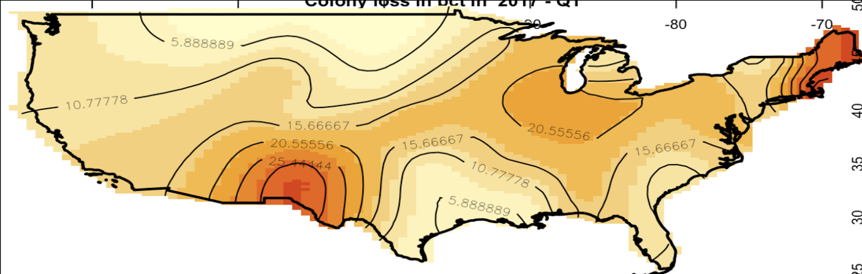
2017 Colony loss (%)
CONCLUSIONS
Good level of precipitation
Cold fall
Medium level of Varroa-Mites
high level of precipitation
mild fall
Medium level of Varroa-Mites
Reduced-risk zone
Avg level of precipitation
Warm fall
High level of Varroa-Mites
High-risk zone

Slide 33
MAIN REFERENCES
Mara S Bernardi et al. ‘A penalized regression model for spatial functional data with application to the analysis of the production of waste in Venice province’.
Eleonora Arnone et al. ‘Modeling spatially dependent functional data via regression with differential regularization’
Federico Ferraccioli, Laura M Sangalli and Livio Finos. ‘Some first inferential tools for spatial regression with differential regularization’.
Alain F. Zuur, Elena N. Ieno, Neil J. Walker, Anatoly A. Saveliev, Graham M. Smith. "Mixed Effects Models and Extensions in Ecology with R"
Notes:
Despite the fact that bees are extremely important, an urgent worry has been raised in the last 20 years due to the global decline in honey bee numbers

Slide 34


